Slide 1
MLA – CIA 4
Presented by
Hemanath Kumar J – 21121015

Slide 2
AGENDA
Introduction & Problem Statement
Methodology & Data understanding
R – EDA
R – Logistic Regression
R – Naïve Bayes
R – Decision Tree

Slide 3
Introduction & Problem Statement
Diabetes is among the most prevalent chronic diseases in the world, impacting millions of people each year and exerting a significant financial burden on the economy.
Diabetes is a serious chronic disease in which individuals lose the ability to effectively regulate levels of glucose in the blood, and can lead to reduced quality of life and life expectancy.
Problem Statement:
While there is no cure for diabetes, strategies like losing weight, eating healthily, being active, and receiving medical treatments can mitigate the harms of this disease in many patients. Early diagnosis can lead to lifestyle changes and more effective treatment, and making predictive models for diabetes risk would be an important tool for public and private health officials.
The objective is to predict, based on diagnostic measurements whether a patient has diabetes or not.

Slide 4
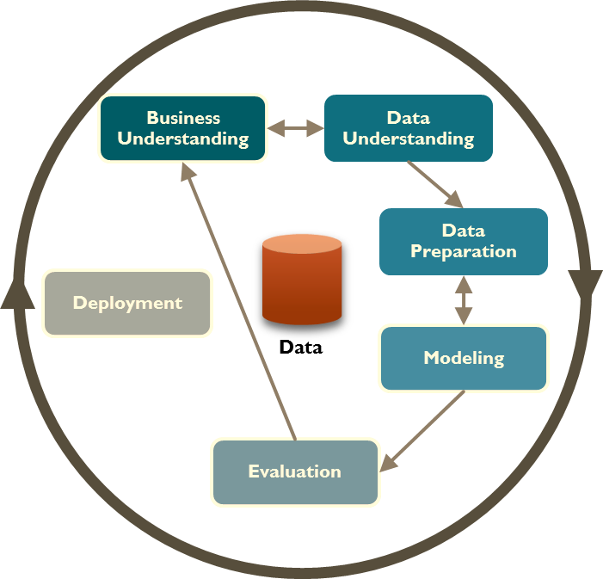
METHODOLOGY

Slide 5
Data Understanding
This dataset is originally from the National Institute of Diabetes and Digestive and Kidney Diseases, India.
Several constraints were placed on the selection of these instances from a larger database. In particular, all patients here are females at least 21 years old of Pima Indian heritage.
Pregnancies: Number of times pregnant
Glucose: Plasma glucose concentration a 2 hours in an oral glucose tolerance test
BloodPressure: Diastolic blood pressure (mm Hg)
SkinThickness: Triceps skin fold thickness (mm)
Insulin: 2-Hour serum insulin (mu U/ml)
BMI: Body mass index (weight in kg/(height in m)^2)
DiabetesPedigreeFunction: Diabetes pedigree function
Age: Age (years)
Outcome: Class variable (0 or 1)

Slide 6
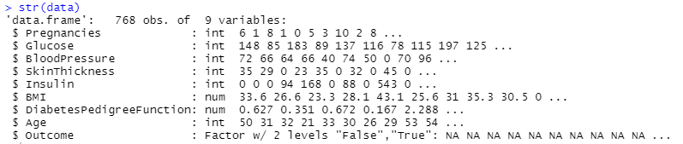
Analysis in R - EDA
Studying the dataset
Str(data) gives us the dimensions, datatype, and sample values.

Slide 7
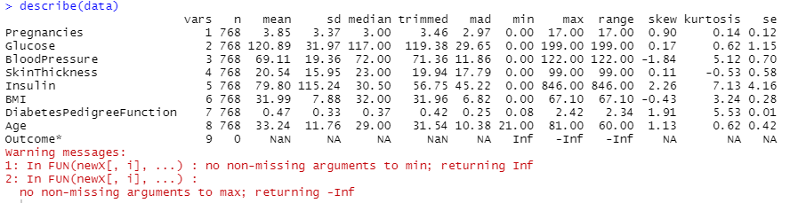
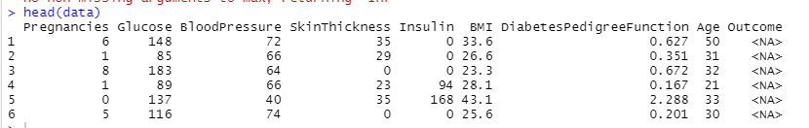
Studying the structure of the data
Statistical values of each variable are observed here and values in the first 6 rows are explored by the head function.

Slide 8
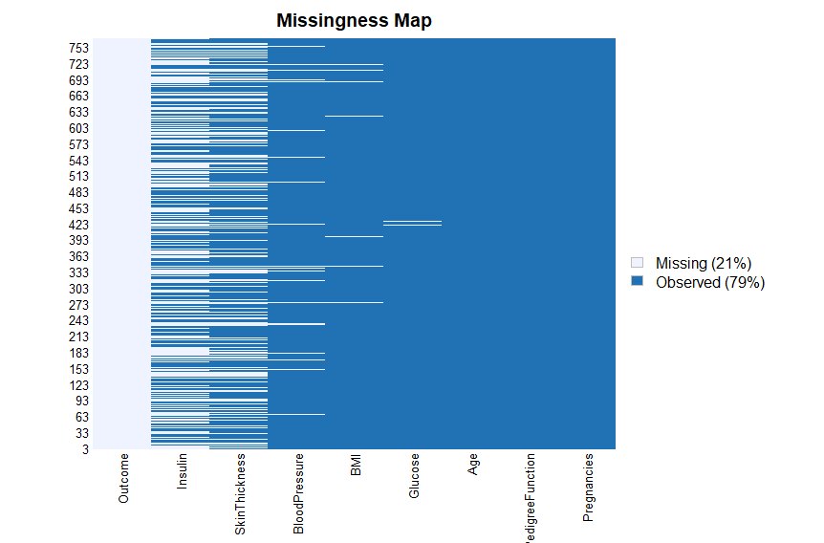
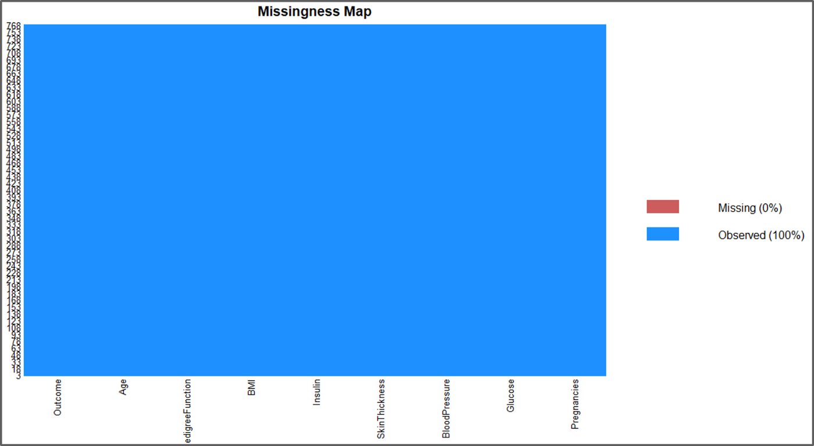
Data cleaning
The map on the left shows that our data set has plenty of missing values and we are removing all of them using the mice package in R.

Slide 9
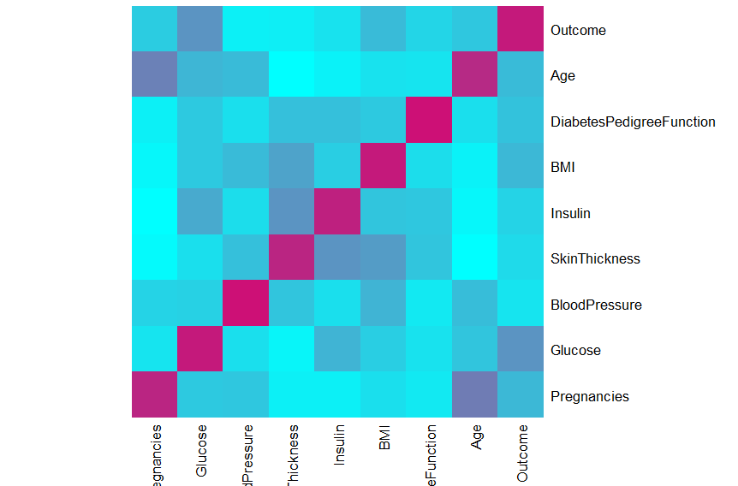
Heatmap
Glucose and Age are highly correlated with the outcome variable

Slide 10
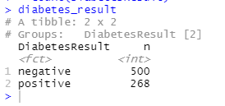
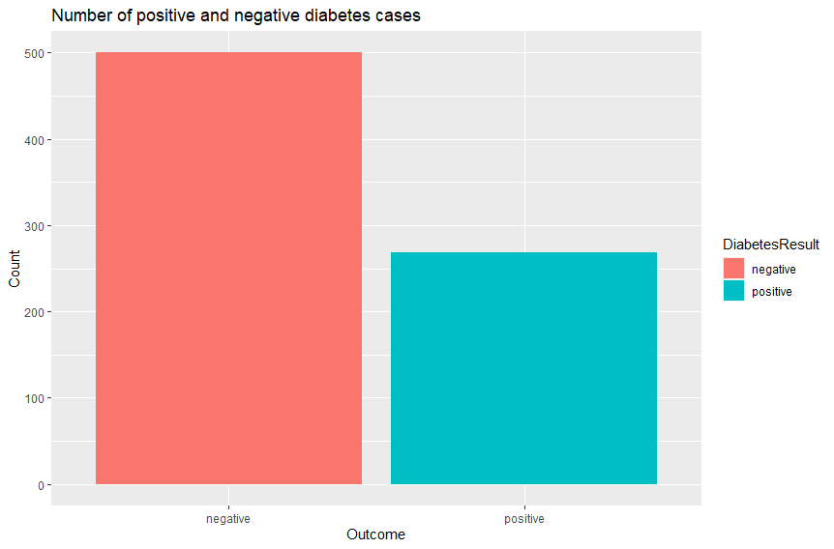
Positive vs Negative cases
Grouped by the count

Slide 11
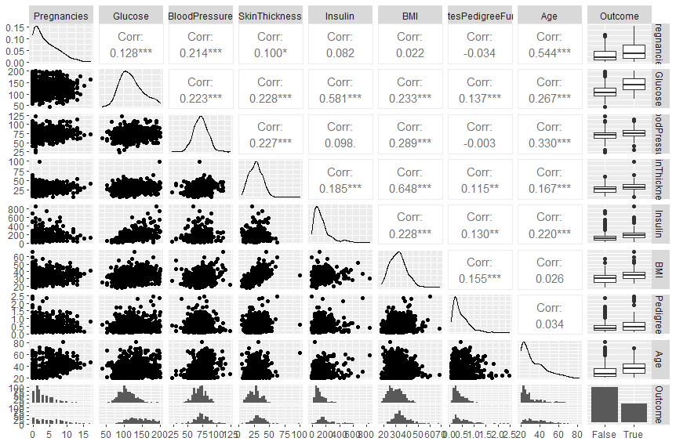
Overall summary - ggpairs

Slide 12
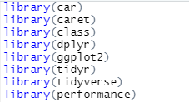
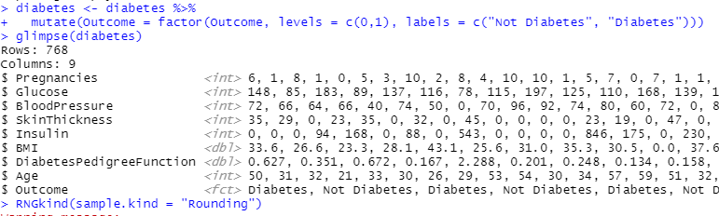
Logistic Regression in R
Libraries required
Transformation into levels

Slide 13
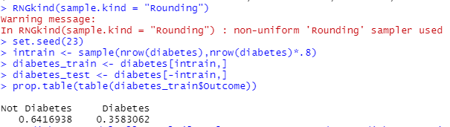
Data Modelling - Cross-validation
Before the model is made, the data needs to be split into a training dataset and a testing dataset. 80% of the data will be used as the training data and the rest of it as the testing data and the proportion of the training data is checked.
The model performance is tested using the testing dataset that we have split above.

Slide 14
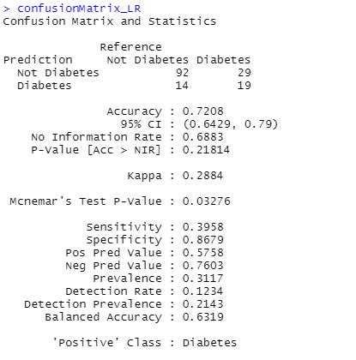
Model evaluation
From testing performance using the testing dataset, we can evaluate our model using a confusion matrix.
In this case, we focus on the comparison between the number of positive observations that are predicted to be positive (True Positive) and the total number of observations that are actually positive (True Positive + False Negative).
Out of 154 observations 43 are predicted wrongly and
111 observations are rightly predicted
Model Accuracy – 72.08%

Slide 15
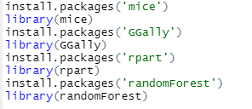
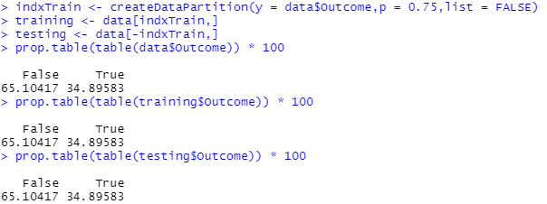
Naïve Bayes in R
Libraries required
Data Modelling

Slide 16
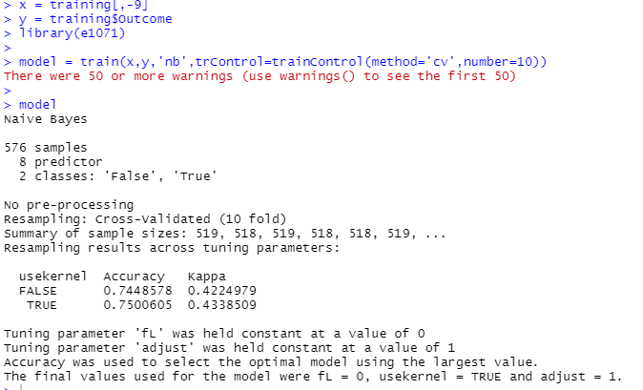
Loading the e1071 package that holds the Naive Bayes function, which is an in-built function provided by R.
Naive Bayes model by using the training data set
Predictive model by using the Naive Bayes Classifier.

Slide 17
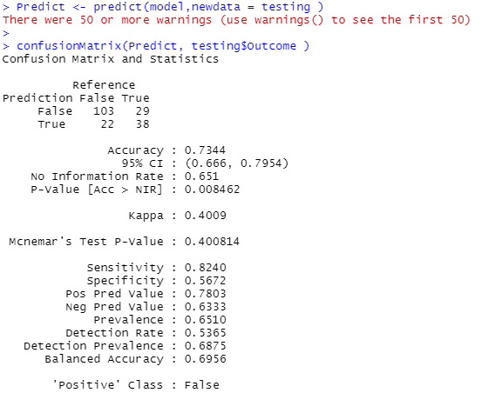
Model Evaluation
To check the efficiency of the model, we are now going to run the testing data set on the model, after which we will evaluate the accuracy of the model by using a Confusion matrix
Out of 192 observations, the model wrongly
Predicted 51 observations and correctly predicted
141 observations.
Model Accuracy – 73.44%

Slide 18

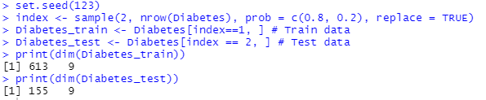
Decision Tree in R
Libraries required
Data modelling
The train data includes 613 observations and
test data included 155 observations.
Both contain 9 variables.

Slide 19
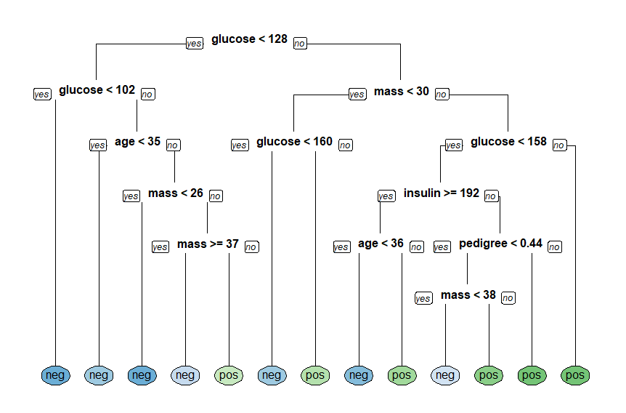
Model training and plotting
For decision tree training, we will use the rpart( ) function from the rpart library. The arguments include; the formula for the model, data, and method.
rpart.plot(x = Diabetes_model, yesno = 2, type = 0, extra = 0)

Slide 20
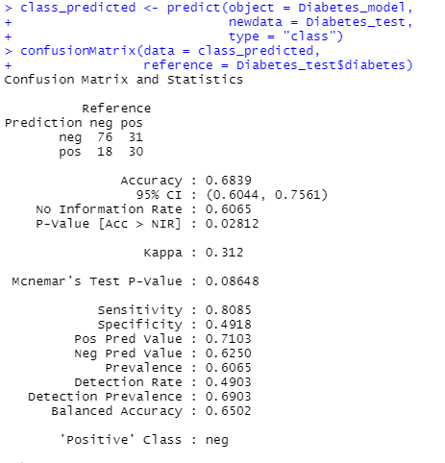

Model Performance & Evaluation
It is observed that out of 155 observations
it wrongly predicts 49 observations and the rest of the
Observations are Predicted right.
The model has achieved about 68.39% accuracy
using a single decision tree.

Slide 21
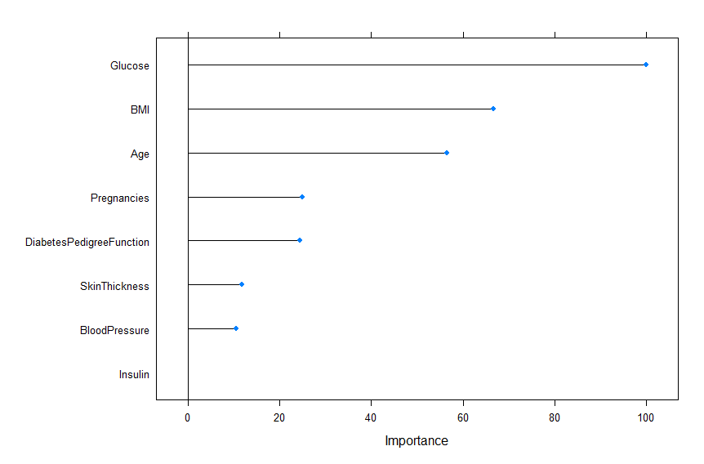
Business insight:
Plot that shows how each predictor variable is independently responsible for predicting the outcome.
From the probability prediction diagram, it can be seen that the majority of the data are negative for diabetes.
‘Glucose’ is the most significant variable for predicting the outcome.

